Slide 1
Transmission of Data via Sound
Datenübertragung mittels Tönen
A overall view for a Bachelor Project by Jordan Eichner

Slide 2
Structure
Motivation
General Idea
Hardware
Protocol of Transmission
Thoughts for Implementation
Discrete Fourier Transform
Overview of Implementation
Protocol between Teensy and PC
Things for later Implementation

Slide 3
Motivation
Most things within research labs or factories are connected for various reasons.
Electric communication either with or without wires produces „electric smog“, that may interfere with fine tuned machines or gauges.
Electric Wireless communication can be disrupted in buildings with strong walls, while sound can survive as an echo to reach its destination.

Slide 4
General Idea
We replicate something similar to old modem technology and transform our stream of bits into a series of sounds on a high frequency on one end.
The receiving end listens with a microphone and filters out all sound of our target frequency, before decoding our signal back to a stream of bits.

Slide 5
Hardware
The base processor should be a Teensy 3.1, which can be programmed with the Ardunio framework.
For Transmission Teensy can use a loudspeaker and maybe a amplifier, that can be used via the Ardunio-Command tone(), that can create our signal on a target frequency up to way above the supersonic limit.
On the receiving end one can connect a microphone and read its input via the onboard ADC, with analogRead().

Slide 6
Protocol of Transmission
As a first idea we could use frequency-shift keying and use 2 symbols(frequencies) representing 0 and 1.
But now we would end up with a half-duplex mode of transmission, which is rather bad in networks with more than 2 participants.
So instead we declare several channels of frequencies with one base frequency and then a offset for the different symbols.
Each participant is given their own channel, which they use to send data, while listening on all other channels for transmission.

Slide 7
Protocol of Transmission
1 Symbol(I) to Identify the Channel. Used for Reservation, see later
2 Symbols(0/1) representing 0/1. Put at the lower and upper end of the bandwidth of a channel, so they don’t get mixed up easily.
1 Symbol(H) representing “Hold”, which will be sent by default, while we communicate via the serial interface with a connected device.
A single Symbol will be sent over the duration of 0.25ms(500 Byte/Second) or some other feasible interval(mainly determined by Disruption of Transmission because of Reverbing)

Slide 8
Protocol of Transmission
Now an example for Transmission from A to B.
A starts up and listens for any Identification.
After 1 second it will take the first free channel and starts sending its Identification.
B starts up and repeat the same process as A.
Now A receives a “01001” to send.
It will send the following Transmission via its channel:
“…II0I1I0I0I1II…”

Slide 9
Thoughts for Implementation
Since we have 0.25 ms to listen for one Symbol we should at least get a sample of sound for every 0.0625 ms.
Because of distance/makeup of the environment we should create thresholds for magnitude of signals, so we can throw away reverberation.
On the same note should the effects of reverberation and other phenomena of sound be taken in for account then defining the limits of frequency for a single symbol.
Since we can have multiple senders at once, we should sort our received bits for every channel.
Mark timeouts for channels. To distinguish between old and new sender.

Slide 10
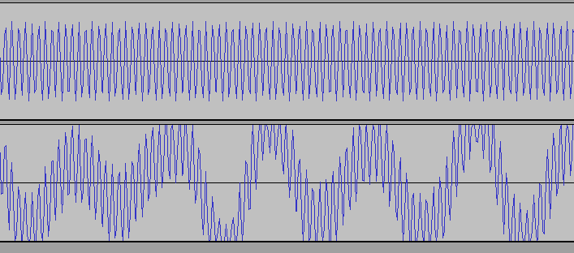
Example of Data

Slide 11
Discrete Fourier Transform
The program needs to filter the single symbols out of the data received by the microphone.
To do so we can use the discrete fourier transform, that computes such input into a array of frequency sections, with their magnitude.
In this project we would implement a Fast Fourier Transform algorithm, which is basically just a faster method and more viable for this purpose.

Slide 12
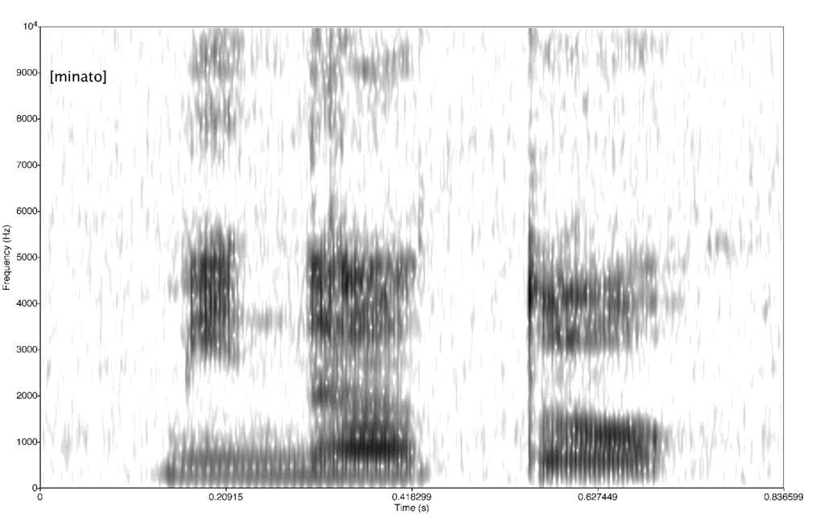
Visual Example FT

Slide 13
Overview of the Software(Teensy Side)
In our setup we configure the microphone and loudspeaker, as well as our serial connection.
The main loop is mainly used for executing the FFT over a sample of data and interpreting those frames of frequencies into symbols and so on.
We also have a number of timed interrupts, probably managed by TimerIntervalls(Teensyduino::Timing)
One for producing the current transmission signal, called every 0.25ms.
One for reading our microphone, the exact timer length I’m not sure about.
And one that is called every 2 seconds or so, to communicate with the serial bus.
At the beginning of our normal opertaion, we also have a phase to find a free channel.

Slide 14
Overview of the Software(Teensy Side)
Because we have a number of interrupts handling the same pool of data(incoming sound and to be transmitted data), we have to find away to keep our memory consistent.
For Data that was received either via the serial connection or from calculations of the FFT, we can use 2 queues.
Our received Sound-Samples are either pushed via a similar method as packets of 0.125 ms of transmission into the FFT or whatever format the specific algorithm needs.
We also should have some flags, to mark the current mode of operation(i.e. initializing, working, communication via serial connect)

Slide 15
Protocol between Teensy and PC(Example)
0, channel: Initialized Communication on channel.
1, channel: Found new Sender on channel
2, channel: Lost Sender on channel, also ends any transmission
3, channel, byte: This byte was received on channel.
4, code: Error with code. <- Details later…

Slide 16
Things that are optional…
On the side of our PC we can add additional protocols to check transmissions for errors and correct them.
Internal protocol to differentiate between types of transmitted data for easy conversion(i. e. strings, floats, …)

